Slide 1

Digital Logic Design

Slide 2
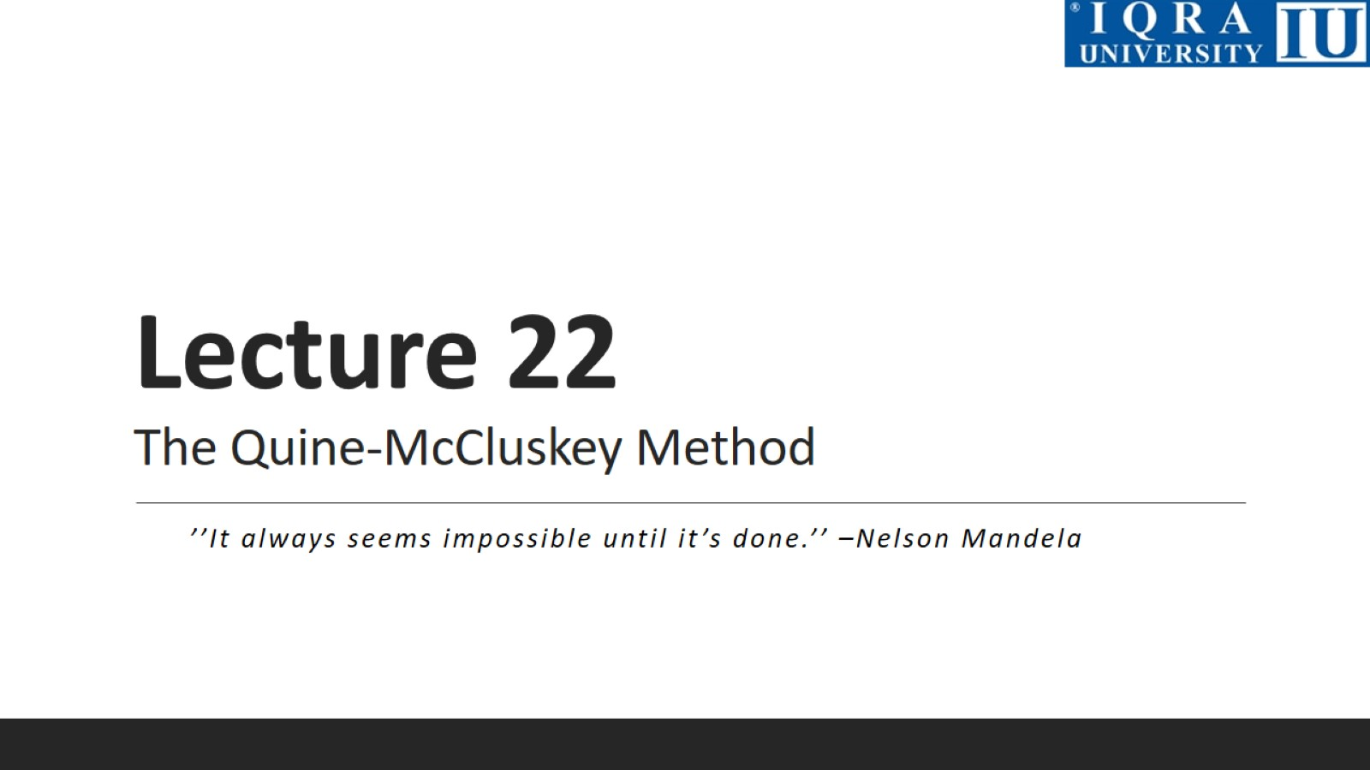
Lecture 22 The Quine-McCluskey Method

Slide 3
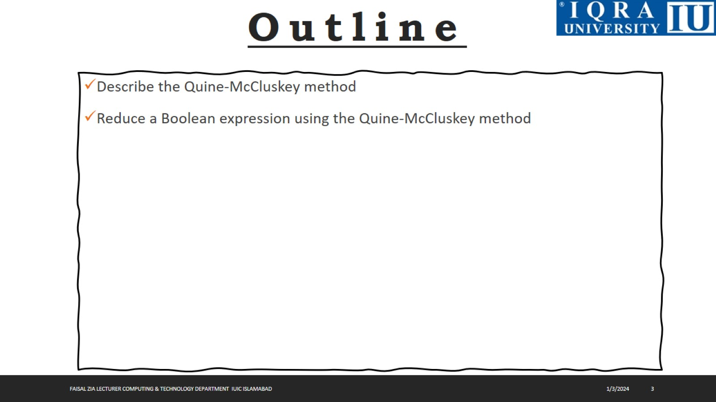

Slide 4
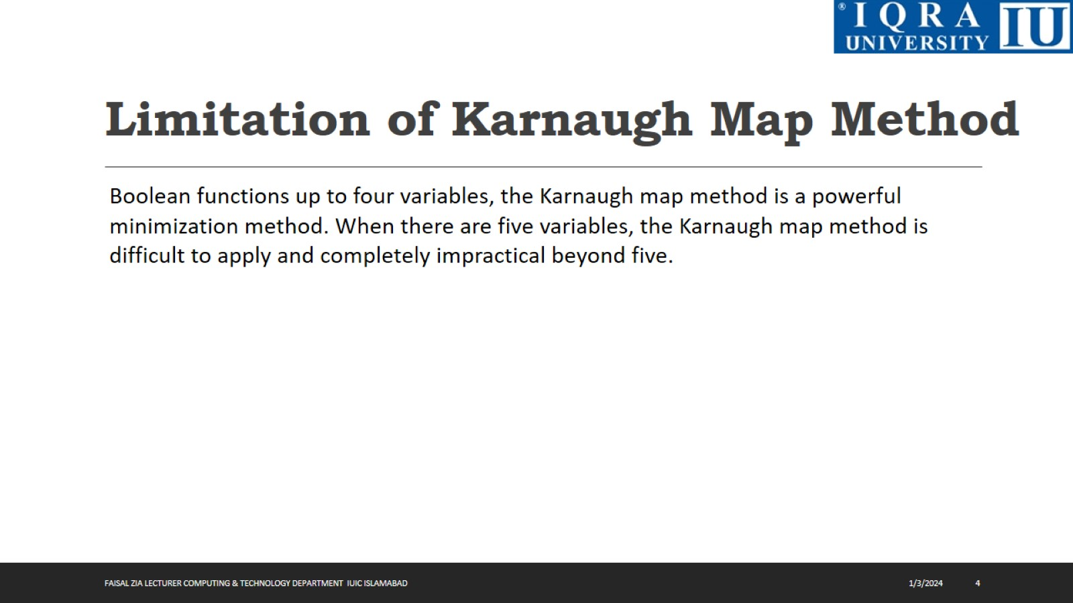
Limitation of Karnaugh Map Method

Slide 5
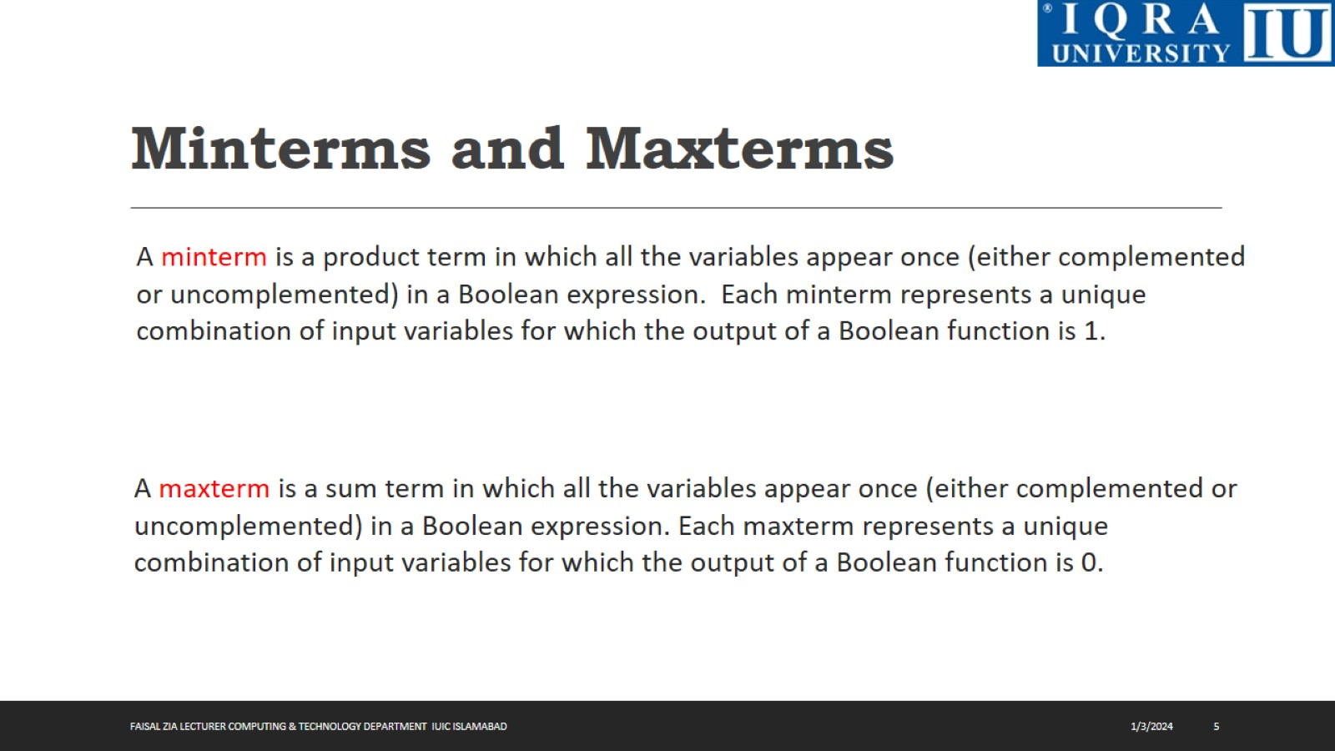
Minterms and Maxterms

Slide 6
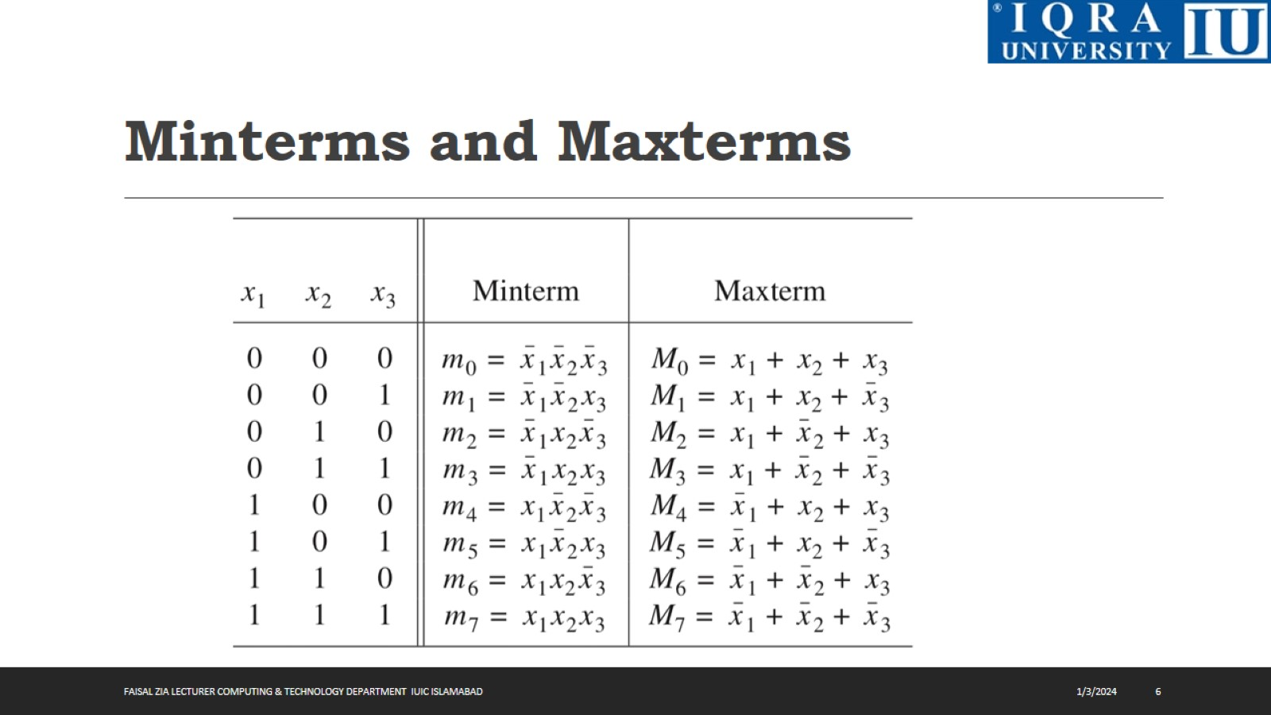
Minterms and Maxterms

Slide 7
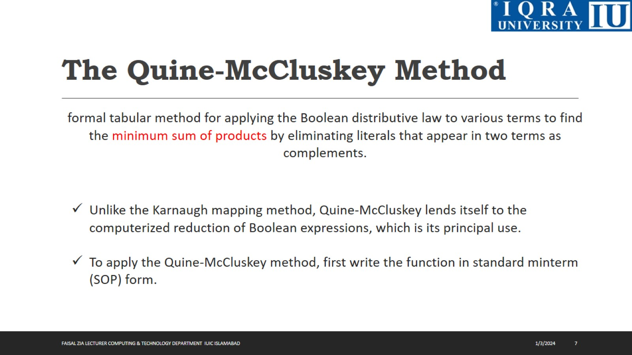
The Quine-McCluskey Method

Slide 8
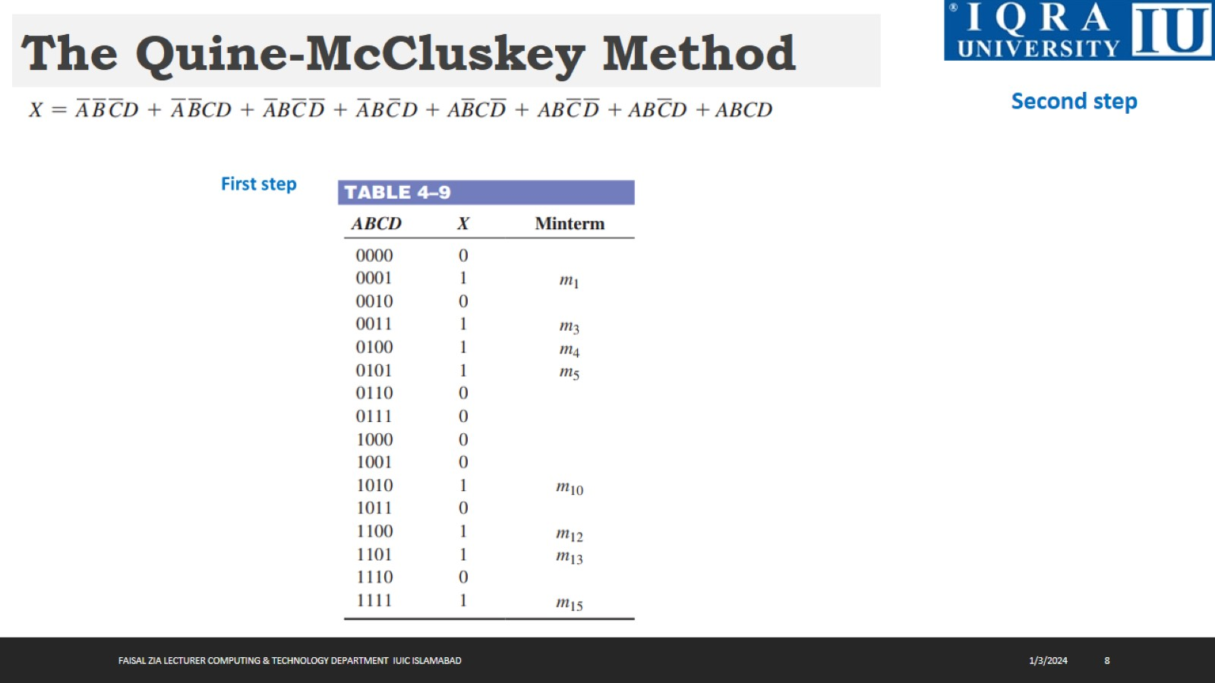
The Quine-McCluskey Method

Slide 9
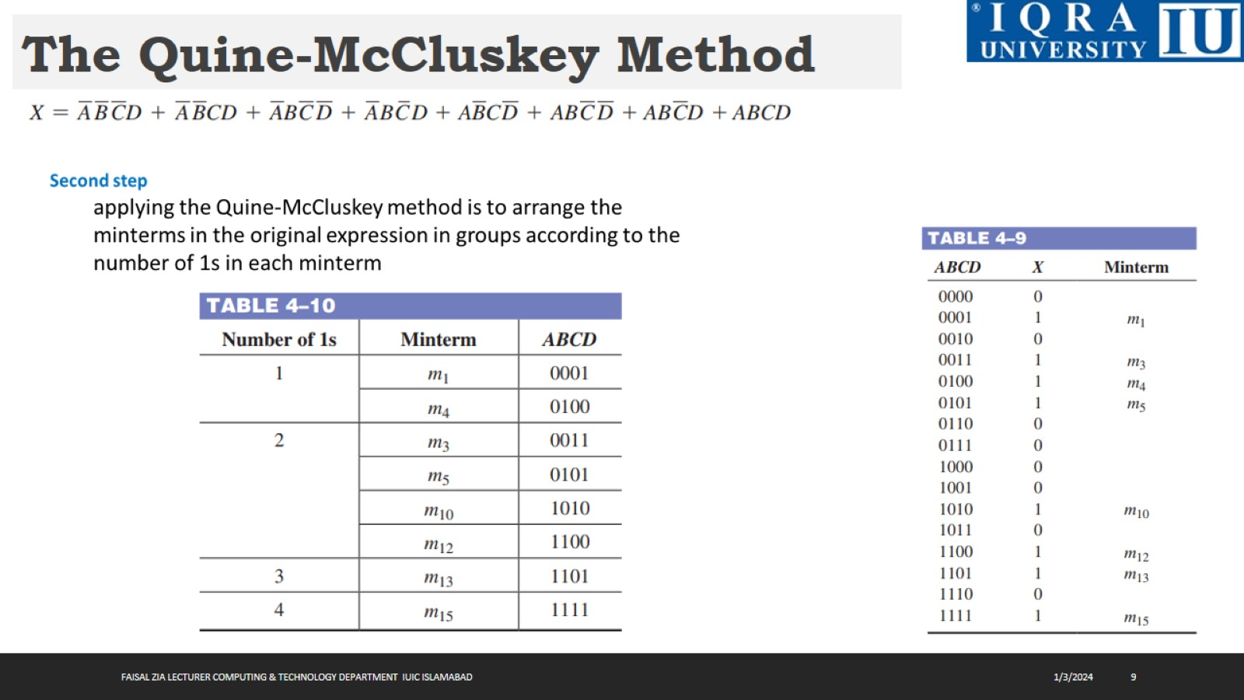
The Quine-McCluskey Method

Slide 10
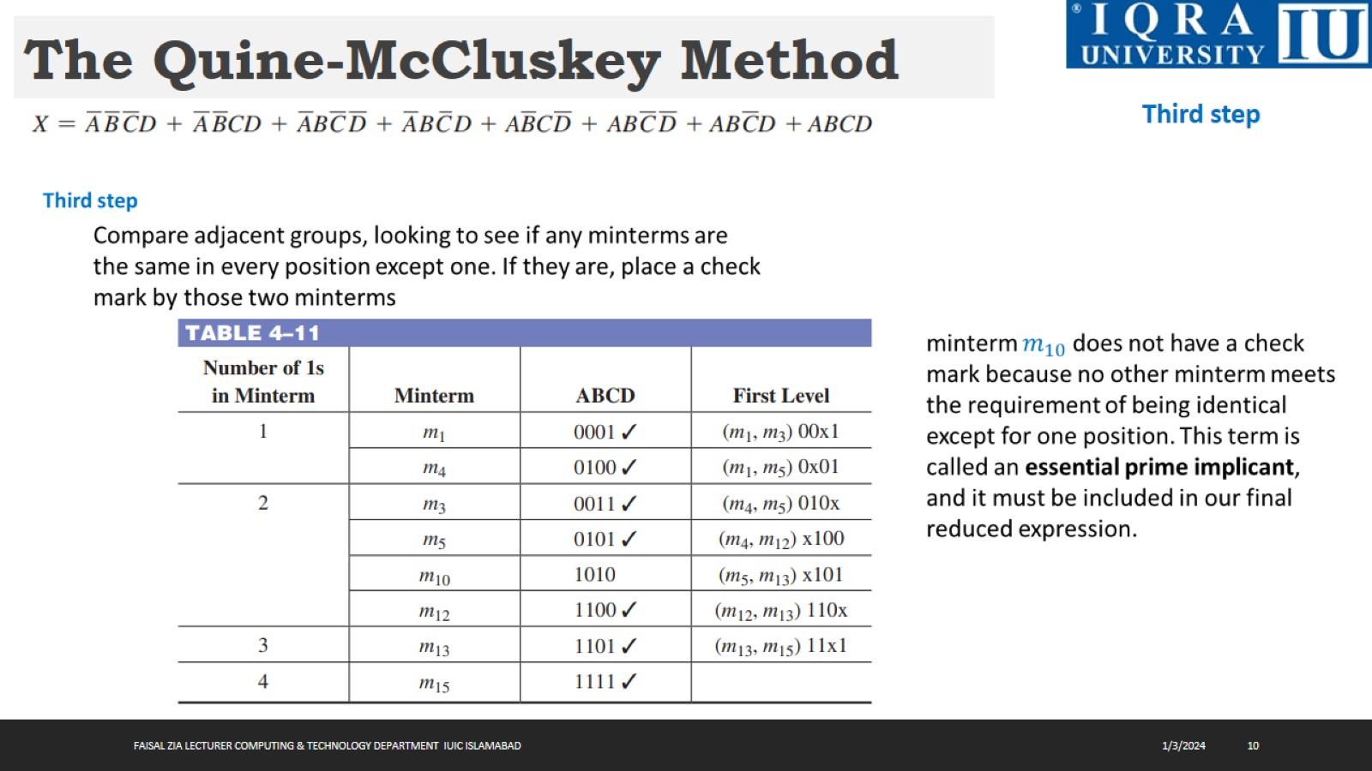
The Quine-McCluskey Method

Slide 11
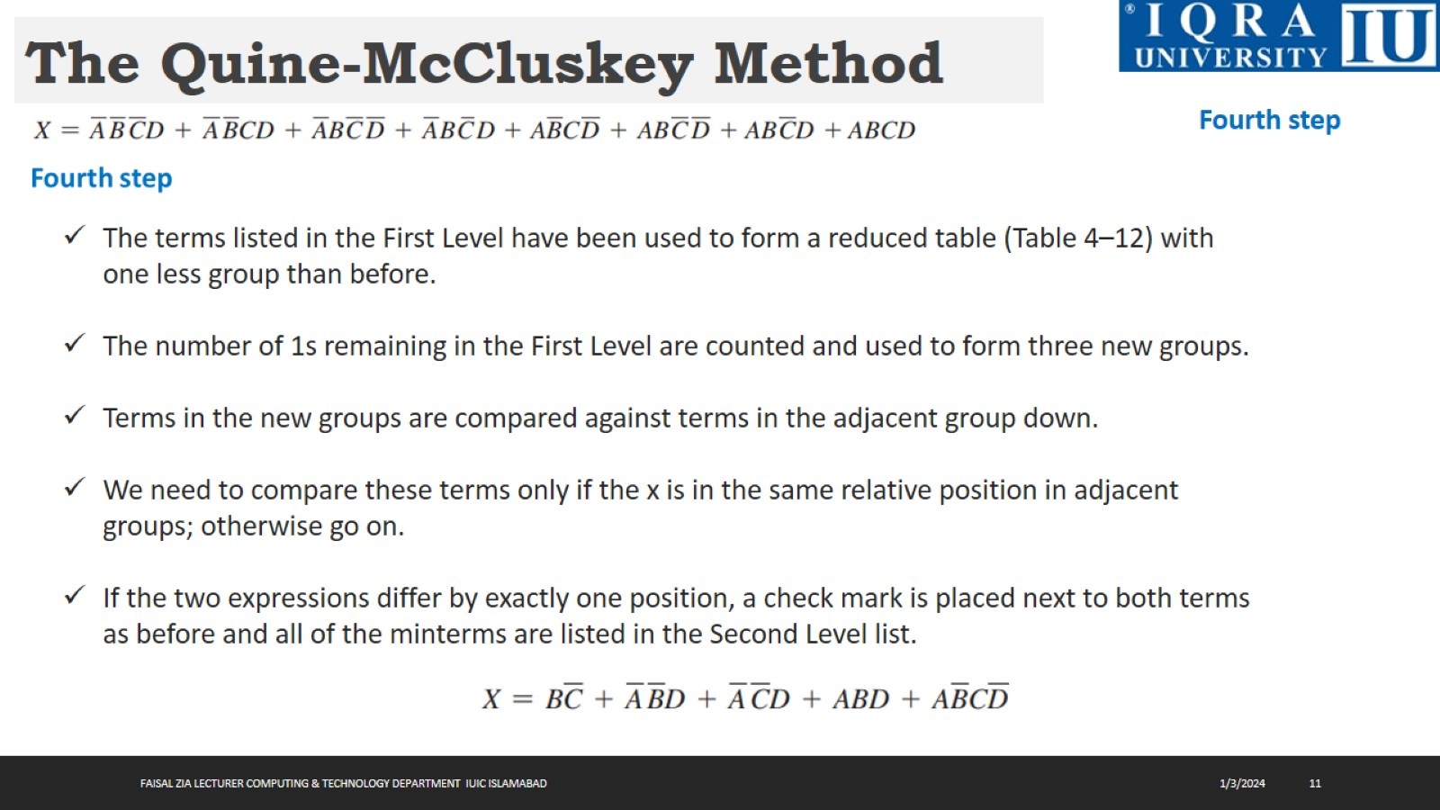
The Quine-McCluskey Method

Slide 12
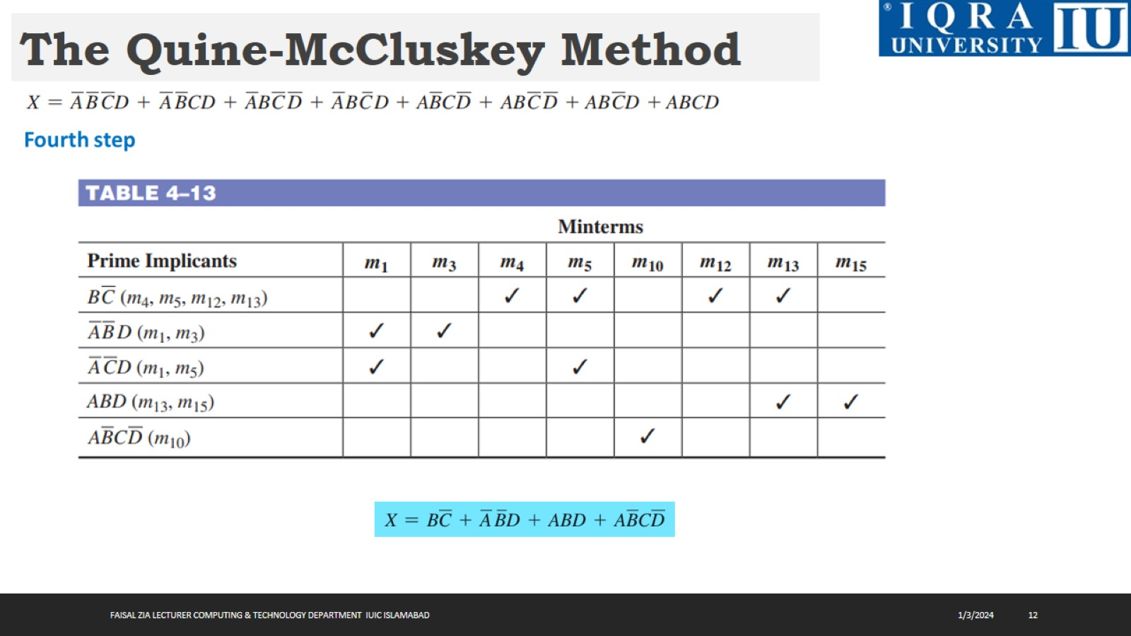
The Quine-McCluskey Method

Slide 13
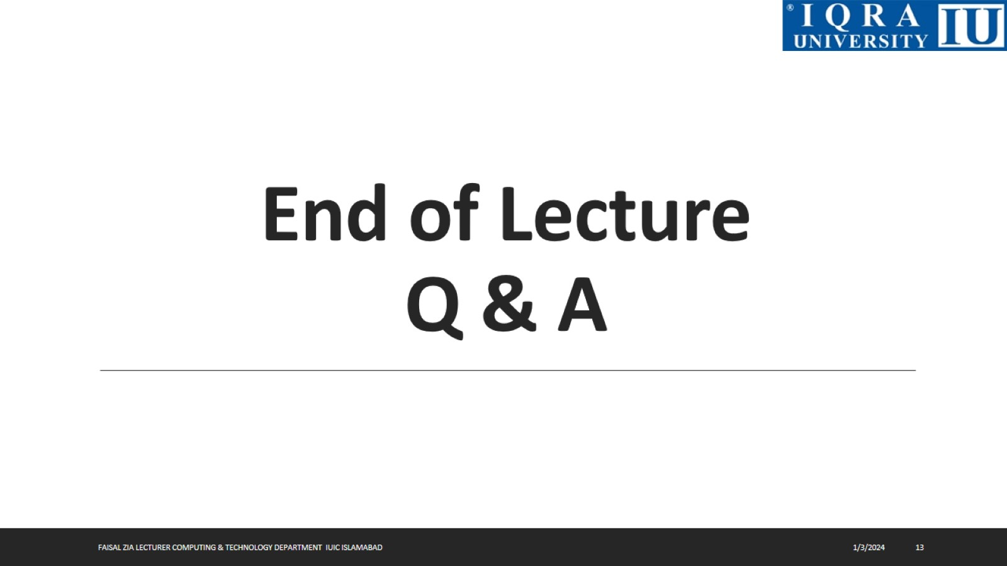
End of Lecture Q & A

